Slide 1
The transformative hope of christ
Hosea 2:13-15

Slide 2
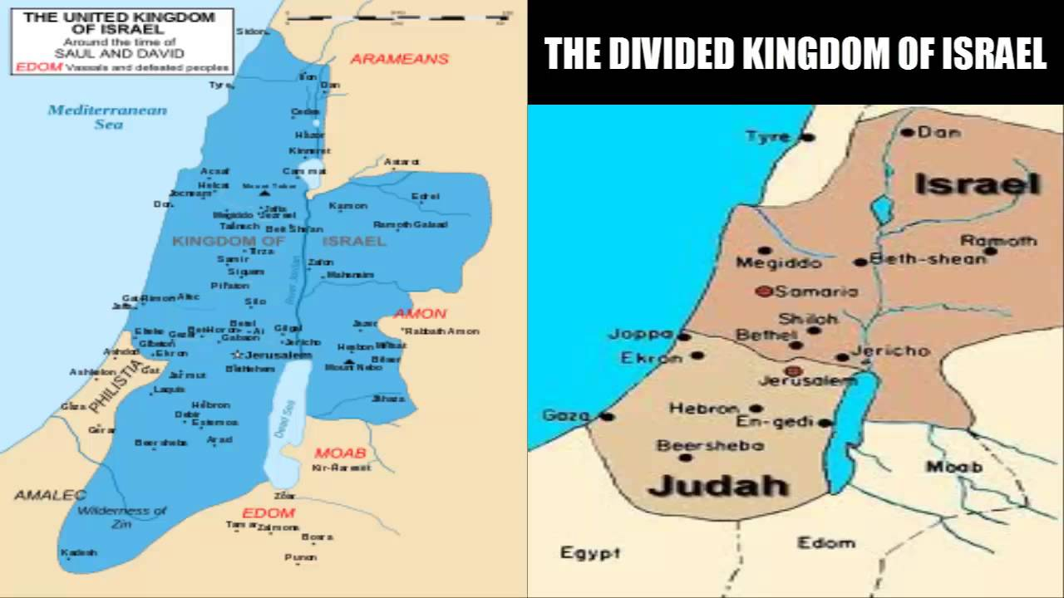

Slide 3
